Slide 1
ML based Ham-Spam detection system
Submitted in the partial fulfillment for the award of the degree of
BACHELOR OF ENGINEERING
IN
Artificail Intelligence and Machine Learning
Submitted by:
BHUDIL MALLICK
21BCS9534
KIRUTHIK RANGA SV
21BCS6765
Under the Supervision of:
KALPANA SINGH (E14950)
Department of AIT-CSE
DISCOVER . LEARN . EMPOWER

Slide 2
Outline
Introduction to Project
Problem Formulation
Objectives of the work
Methodology used
Results and Outputs
Conclusion
Future Scope
References

Slide 3
Introduction to Project
Title: ML based Ham-Spam Detection System
Presenter: Bhudil Mallick and Kiruthik Ranga
Date: 26/08/23
Institution: Chandigarh University
Branch: CSE-AIML

Slide 4
Introduction to Project
The main tasks of this project are as follows-
1. To analyze the existing work related to Ham-Spam detection system.
2. To evaluate the efficiency of model using computer vision model based on evaluation parameters.

Slide 5
Problem Formulation
Spam emails are a growing nuisance which impacts users' time and security.
The need for an automated solution to differentiate between legitimate (ham) and spam emails or SMS, leads to the development of this project
The goal is to develop an effective machine learning model for accurate ham-spam classification which will make the it easier for the user to segregate his SMS or Emails.

Slide 6
Objectives of the Work
Create a machine learning-based ham-spam detection system to classify SMS.
Achieve high accuracy and precision in classifying emails.
Reduce false positives and negatives to improve precision and recall
Improve user experience and email/SMS security.

Slide 7
Feature/characteristics Identification
1. Email Header Information:
Features: Sender's email address, receiver's email address, subject line, date and time of sending, IP address of the sender, etc.
Importance: Email headers can provide valuable information about the sender and the email's origin. Anomalies or suspicious patterns in these fields can indicate spam.
2. Email Content:
Features: Text content, words, phrases, frequency of specific terms, HTML tags, etc.
Importance: Analyzing the actual content of the email is crucial. Spam emails often contain specific keywords, phrases, or patterns (like offers, discounts, urgent calls to action) that are rare in legitimate emails.
3. Textual Patterns:
Features: Punctuation usage, capitalization patterns, grammatical errors, etc.
Importance: Spam emails might use excessive punctuation, inconsistent capitalization, or deliberate grammatical mistakes to bypass filters. Identifying these patterns can be effective.

Slide 8
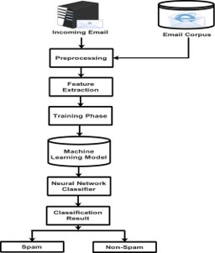
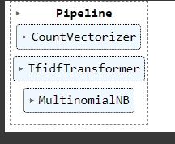
Design Selection

Slide 9
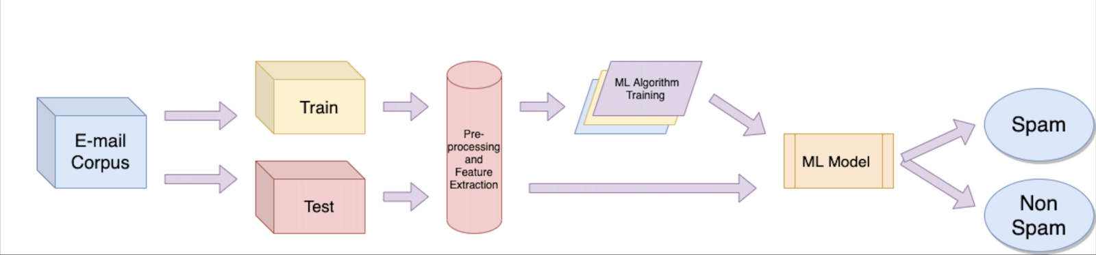
Design Selection

Slide 10
Constraint Identification
Feature Extraction:-
Constraint: Converting raw email text into machine-readable features without losing essential information.
Handling: Use techniques like TF-IDF (Term Frequency-Inverse Document Frequency) and word embeddings to transform text data into numerical features. Experiment with various NLP techniques to capture the semantic meaning of words and phrases effectively.

Slide 11
Constraint Identification
Class Imbalance:
Constraint: Ham emails significantly outnumber Spam emails, leading to a class imbalance problem.
Handling: Apply techniques such as oversampling the minority class, undersampling the majority class, or using algorithms that are inherently robust to class imbalance, like ensemble methods and cost-sensitive learning.

Slide 12
Methodology used
Data Collection: Gather a dataset of labeled emails (ham and spam).
Data Preprocessing: Clean, tokenize, and prepare the text data for analysis.
Feature Extraction: Convert text data into numerical features (TF-IDF, word embeddings).
Model Selection: Choose appropriate machine learning algorithms (Naive Bayes, SVM, etc.).
Model Training: Train the selected models on the preprocessed data.
Model Evaluation: Use metrics like accuracy, precision, recall, and F1-score.
Hyperparameter Tuning: Optimize model performance through parameter tuning.

Slide 13
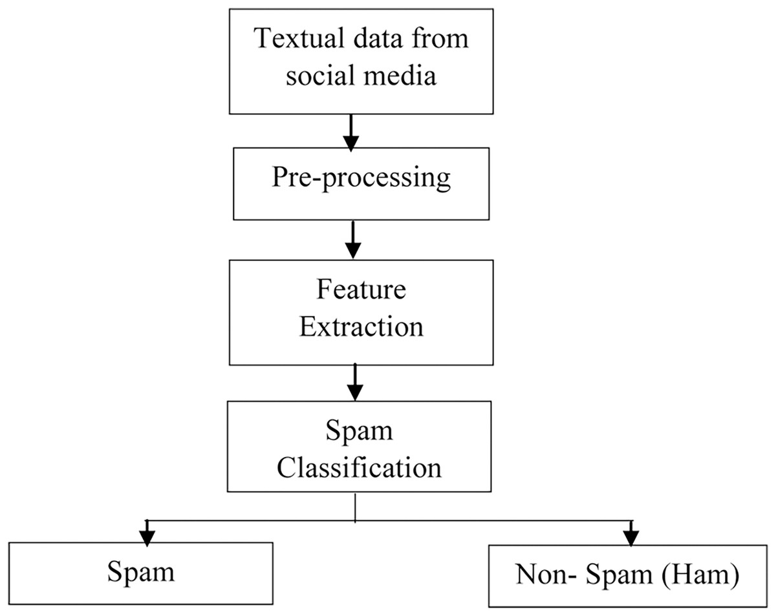
Methodology used

Slide 14
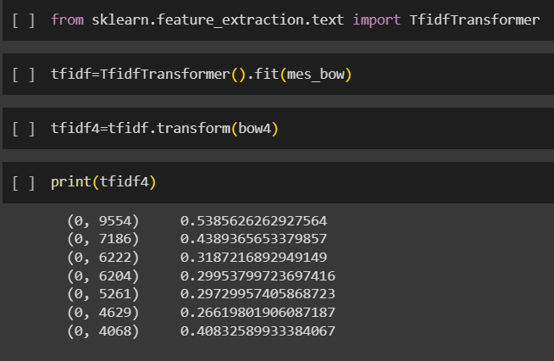
Analysis of Features
Words and Tokens: Traditional Bag of Words (BoW) or Term Frequency-Inverse Document Frequency (TF-IDF) features capture the presence and frequency of words or tokens in emails.
N-grams: Including bi-grams or tri-grams can capture contextual information and improve the model's ability to distinguish between ham and spam.
Stemming and Lemmatization: Reducing words to their base form helps in feature normalization and reduces feature dimensionality.

Slide 15
Analysis of Features
Scikit-Learn (sklearn):
Role: Scikit-Learn is a versatile library for machine learning in Python. It provides tools for data preprocessing, feature selection, model training, and evaluation.
Functions:
Feature preprocessing (e.g., text preprocessing, scaling).
Feature selection techniques (e.g., SelectKBest for feature selection).
Implementation of various machine learning algorithms for classification.
Model evaluation metrics (accuracy, precision, recall, F1-score).
NLTK (Natural Language Toolkit):
Role: NLTK is a library specifically designed for natural language processing (NLP) tasks. It is useful for text-based feature analysis and preprocessing.
Functions:
Text tokenization.
Stopword removal.
Stemming and lemmatization.
Part-of-speech tagging.
Named entity recognition.

Slide 16
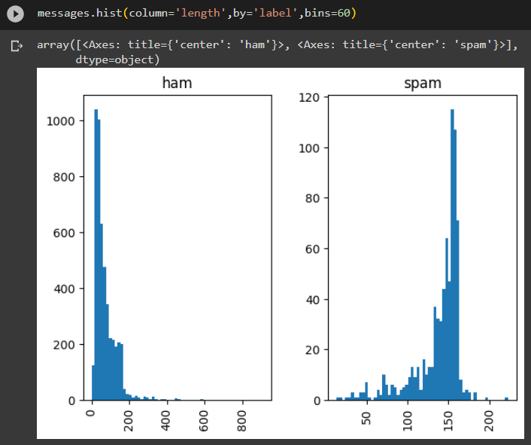
Results and Outputs
Checking the SMS length of Ham or Spam data (Histogram)

Slide 17
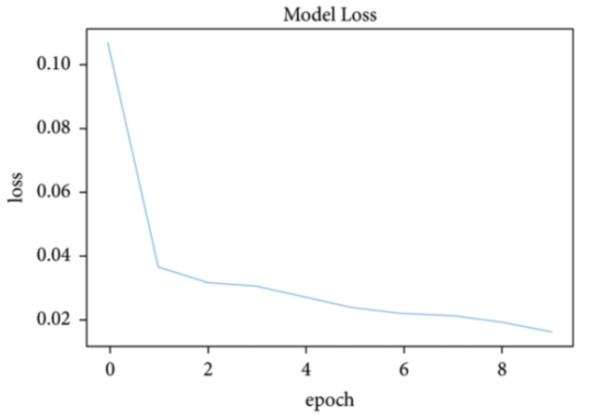
Results and Outputs
ROC Curve to check the model losses in each iteration(epoch)-

Slide 18
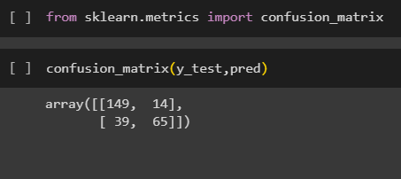
Results and Outputs
Show the confusion matrix of the model representing the false negatives and positives-

Slide 19
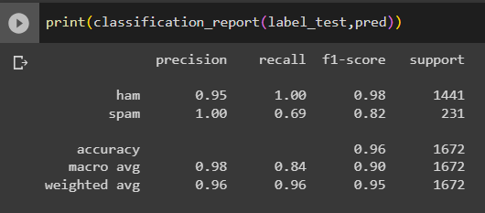
Results and Outputs
Deduce the precision, recall, f1-score and accuracy of the model-

Slide 20
Conclusion
In conclusion, a machine learning-based ham-spam detection model can be an effective solution to filter out unwanted messages and improve communication.
The process involves collecting and preprocessing data, extracting relevant features, training and evaluating the model, optimizing its performance, deploying it in a real-time application, and continuously monitoring and maintaining it.
Various machine learning algorithms such as Support Vector Machines, Naive Bayes, Logistic Regression, and Deep Learning can be used to build the model.
The model can be trained on datasets of labeled messages.
The performance of the model can be evaluated using metrics such as accuracy, precision, recall, and F1 score.

Slide 21
Future Scope
Explore deep learning techniques for more complex feature extraction.
Implement real-time detection for dynamic email classification.
Extend the system to classify other types of text data (social media posts, reviews).
Collaborate with email or SMS service providers for practical implementation.

Slide 22
References
N. Kumar, S. Sonowal, and Nishant, “Email spam detection using machine learning algorithms,” in Proceedings of the 2020 Second International Conference on Inventive Research in Computing Applications (ICIRCA), pp. 108–113, IEEE, Coimbatore, India, July 2020.
G. Jain, M. Sharma, and B. Agarwal, “Optimizing semantic lstm for spam detection,” International Journal of Information Technology, vol. 11, no. 2, pp. 239–250, 2019.
F. Masood, G. Ammad, A. Almogren et al., “Spammer detection and fake user identification on social networks,” IEEE Access, vol. 7, pp. 68140–68152, 2019.
A. Akhtar, G. R. Tahir, and K. Shakeel, “A mechanism to detect Urdu spam emails,” in Proceedings of the 2017 IEEE 8th Annual Ubiquitous Computing, Electronics and Mobile Communication Conference (UEMCON), pp. 168–172, IEEE, New York, NY, USA, Oct 2017.
H. Drucker, D. Donghui Wu, and V. N. Vapnik, “Support vector machines for spam categorization,” IEEE Transactions on Neural Networks, vol. 10, no. 5, pp. 1048–1054, 1999.

Slide 23
References
H. Afzal and K. Mehmood, “Spam filtering of bi-lingual tweets using machine learning,” in Proceedings of the 2016 18th International Conference on Advanced Communication Technology (ICACT), pp. 710–714, IEEE, PyeongChang, Korea (South), Feb 2016.
S. K. Tuteja and N. Bogiri, “Email spam filtering using bpnn classification algorithm,” in Proceedings of the 2016 International Conference on Automatic Control and Dynamic Optimization Techniques (ICACDOT), pp. 915–919, IEEE, Pune, India, Sep 2016.
M. Mohamad and A. Selamat, “An evaluation on the efficiency of hybrid feature selection in spam email classification,” in Proceedings of the 2015 International Conference on Computer, Communications, and Control Technology (I4CT), pp. 227–231, IEEE, Kuching, Malaysia, Apr 2015.
S. Suryawanshi, A. Goswami, and P. Patil, “Email spam detection: an empirical comparative study of different ml and ensemble classifiers,” in Proceedings of the 2019 IEEE 9th International Conference on Advanced Computing (IACC), pp. 69–74, IEEE, Tiruchirappalli, India, Dec 2019.

